Slide 1
Invoice reconciliation & review
AI reads the invoice. Code decides what it means.
reconciled
discrepant
unresolved
duplicate
Notes:
Hi, I built a small accounts-payable review tool for a fictional business. It reads invoice images with a vision model, matches them to purchase orders and receipts, and shows a reviewer what was ordered, received and billed. The one idea behind every decision: the model only reads and writes text, all arithmetic and every decision is plain, tested Python.

Slide 2
One pipeline, two jobs for the model
Image
Extract
Normalize
Match
Reconcile
Draft note
PNG, two layouts, multi-line
Gemini 2.5 Flash, JSON schema, strings as printed
Decimal to integer cents, validate
exact supplier + PO, lines by SKU
findings, status, duplicates, totals
from verified findings only
input
Gemini
Python
Python
Python
Gemini
Model reads and phrases. It returns printed values ("24.00") and null for anything missing, never a guess.
Python computes and decides. Every amount, match and status is deterministic and covered by 122 tests.
A reviewer closes the loop. Streamlit UI: image beside fields, corrections rerun the whole batch and persist on disk.
Notes:
The pipeline has six steps. The model appears twice: it extracts fields from the image, and it drafts a short discrepancy note at the end. Everything in between is Python: converting printed amounts to integer cents, matching to the purchase order, computing expected versus billed, detecting duplicates. Results are saved as JSON files, and the Streamlit UI sits on top.

Slide 3
Decisions that keep the numbers trustworthy
1
Integer cents only
2
Exact matching only
3
Null beats a guess
Decimal parsing; more than two decimals is an error. Expected = ordered qty × agreed price, so rounding is never needed.
Supplier + PO-ID, lines by SKU. A misread "PO-S" stays unresolved instead of silently becoming PO-5.
Missing or placeholder fields come back null with a warning. No confidence scores: self-reported confidence is not calibrated.
4
Original is immutable
5
Replay by default
6
Provenance labels
Corrections are an overlay with history and pass the same validation as model output.
Saved real Gemini responses run the whole app and the tests without an API key.
Each extraction and note is labelled live, cached or simulated, so a simulation never passes as real.
Notes:
Six decisions carry most of the reliability. Money is integer cents parsed with Decimal, so there is never a rounding question. Matching is exact: if the model misreads PO-5 as PO-S, the invoice stays unresolved instead of being fuzzily matched. The model returns null rather than guessing. Corrections never overwrite the original extraction. And every result says where it came from: a live call, a cached real response, or a labelled simulation.

Slide 4
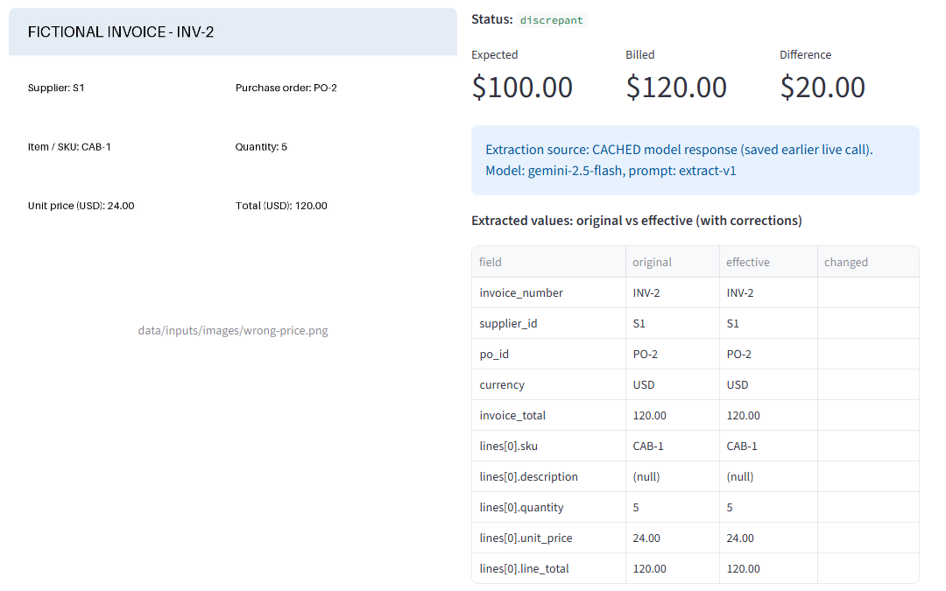
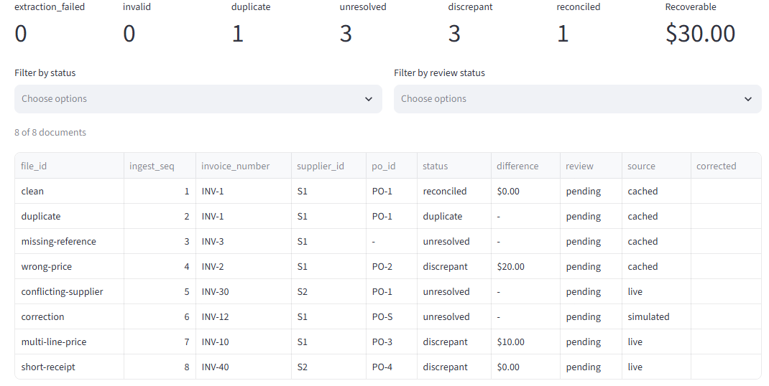
The reviewer sees evidence, not just a verdict
Review queue with status counts and filters
Correct a field, the whole batch is re-reconciled
Corrections and review status survive a restart
Draft notes are labelled DRAFT and number-guarded
Invoice detail: original image, expected vs billed, extraction source, original vs corrected values
Notes:
Here is the wrong-price invoice. On the left is the original image, on the right the expected 100 dollars against 120 billed, a 20 dollar difference, plus where the extraction came from. The table shows original and corrected values side by side. The queue gives status counts and filters. A correction reruns reconciliation for the whole batch, because a corrected invoice number can change which invoice is the duplicate.

Slide 5
11 of 11 checks pass against independent results
11/11
Check | Case | Verified result | Status
M1 | clean | $100.00 expected = $100.00 billed | reconciled
M2 | wrong-price | +$20.00, unit $24.00 vs agreed $20.00 | discrepant
M3 | duplicate | duplicate of clean, not payable | duplicate
M4 | missing-reference | no PO, expected and difference null | unresolved
M5 | correction | PO-S to PO-5: unresolved to reconciled, kept after restart | reconciled
+ | conflicting-supplier | PO-1 belongs to another supplier | unresolved
+ | multi-line-price | +$10.00 on the ADP-2 line only | discrepant
+ | short-receipt | received 4 of 6; no amount invented | discrepant
checks passed in replay mode, no API key
$30.00
recoverable, from discrepant invoices only
Notes:
The check report compares the application against expected values that a separate script computed from structured records, never from app output. All five mandatory checks pass: the clean match, the 20 dollar price difference, the duplicate excluded from totals, the missing PO that stays unresolved, and a correction that moves an invoice from unresolved to reconciled and survives a restart. Three more cases and three batch-level checks also pass, including one where a forced failure on one invoice does not stop the batch.

Slide 6
Test data built to catch shortcuts
4 + 4
!
PO-1 and PO-2 are identical
Gaps in the rules, made explicit
Only the PO-ID can match; amount-based matching cannot.
Short receipt: flagged, no amount invented
Undercharge: shown, not recoverable
Duplicate and discrepant: duplicate wins
One unresolved line: whole invoice unresolved
15 ambiguities logged; open questions went to me, not decided silently
supplied seed invoices plus generated ones, both layouts, multi-line
!
Two byte-identical images
clean vs duplicate: the first processed is the original.
!
Same SKU, different price
S2 pays 18.00 for CAB-1: prices come from the matched PO only.
!
Wrong supplier, amounts fit
PO-1 belongs to S1, so it stays unresolved.
Notes:
The data was designed to catch shortcuts. The two seed purchase orders are identical, so only the PO number can match. The clean and duplicate images are byte-identical, so which one is the original has to come from processing order. Supplier S2 has a different price for the same SKU. Where the supplied rules were silent, for example a short receipt, I recorded a decision instead of inventing an amount. Fifteen of these are documented.

Slide 7
Built with an implement, test, review loop
Orchestrator
Implementer
pytest gate
Reviewer
Me
plans the phase
writes code + tests
replay, no key
read-only, checklist
approve each phase
Implementer stopped and asked
Reviewer blocked a phase
Checks caught a spec conflict
A rule from phase 1 made all four seed invoices invalid (the images print no description). I changed the rule; the doc version was snapshotted.
The UI crashed on an older Streamlit, and a skip-if-missing test hid the correction flow. Fixed in round 2.
The expected file and the app disagreed on which invoices are payable; the checker had skipped the field. Resolved as a recorded decision.
Notes:
I used Claude Code as an orchestrator with two subagents. The implementer writes one phase with its tests, a pytest gate runs in replay mode, and a read-only reviewer checks the diff against a checklist: no float money, no fuzzy matching, no reading the answer key, inputs untouched. I approved every phase. Three moments show why this mattered: the implementer stopped and asked when one of my rules broke all seed invoices; the reviewer blocked the UI phase because it crashed on an older Streamlit and a test was silently skipped; and the check report exposed a disagreement about which invoices count as payable.

Slide 8
Honest limits and next steps
Limitations
Next
Eight clean, rendered invoices: little evidence of extraction accuracy on real scans
The correction case starts from a labelled simulated misread, not a real model error
The note guard checks that amounts exist in the findings, not that each is in the right place
One PO per invoice, USD only; a corrupt state file stops a run (visibly)
Evaluate extraction on scanned and noisy invoices, per field
Field-level note guard and PDF input
Export of the queue and reviewer decision history
Notes:
To be honest about the limits: eight clean rendered invoices say little about accuracy on real scans, the correction demo starts from a labelled simulated misread, and the note guard checks that amounts exist rather than that each sits in the right place. Next I would evaluate extraction on noisy scans field by field, tighten the guard, and add PDF input and export. Everything runs without an API key in replay mode. Thanks.

